Slide 1
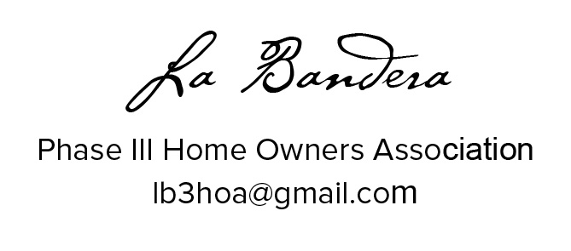

Slide 2
Did you sign the voting/attendance list?
    If not, please do so now.
    One signature is required for each address present.
    This list is used to verify our ballot totals for the election of the board at the end of this meeting.
    Each address is allowed one vote/one ballot.

Slide 3
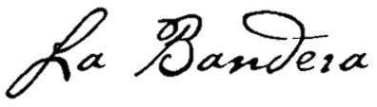
Meeting Agenda
Introduce 2016/17 Board
HOA Organization
HOA Mission
Financial Overview
Recap of HOA Actions
Review of Board Positions
Election for 2017/18 Board

Slide 4
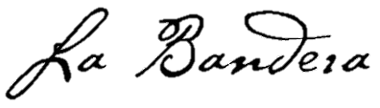
Introduce 2016/17 Board
President: Brian Lott
Vice President: Mike Seraphin
Secretary: Shannon Hart
Architectural Control Chair/Member At Large: Ken Hassler
Treasurer: David Jeffreys

Slide 5
HOA Organization
Team Ranch
Master Association
La Bandera Phase 1/2
La Bandera Phase 3
Part of the HOA dues collected is paid to the Master Association
Control of La Bandera Phase 3 HOA was passed to residents in 2007
La Bandera Phase 3 has 111 Homes – La Bandera, Tejas, Arroyo, Plata, Pico

Slide 6
HOA Mission
Maintain our community for the common good and general welfare of the subdivision and its members
Enhance the property values for all residents
Uphold the integrity of Team Ranch Master Association

Slide 7
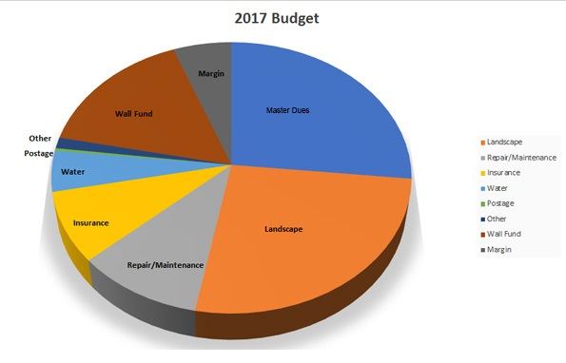
Financial Overview
2017 Budget
Expense Category | 2017
Master Dues | $8,349
Landscape | $6,000
Repair/Maintenance | $1,500
Insurance | $2,643
Water | $1,400
Postage | $200
Other | $290
Wall Fund | $5,000
Margin | $2,370
Total | $27,752
Per Household | $250
HOA dues for 2017 are $250
All 2017 dues as well as outstanding dues for 2016 have been collected
A portion of the dues is allocated for the required Team Ranch Master Association dues and the City of Benbrook Reserve “Wall” Fund
  The City requires the HOA to accrue a fund of $41,650 within 8 years

Slide 8
Financial Overview
Budgetary Analysis
Expense Type | 2010 | 2011 | 2012 | 2013 | 2014 | 2015 | 2016
Landscape | $ 6,468 | $ 6,550 | $ 7,740 | $ 7,699 | $ 7,231 | $ 8,054 | $ 10,059
Master Dues | $ 7,203 | $ 7,203 | $ 7,203 | $ 7,203 | $ 7,203 | $ 8,349 | $ 8,349
Wall Fund | $ 5,000 | $ 5,045 | $ 5,086 | $ 5,000 | $ 5,000 | $ 5,000 | $ 5,000
Insurance | $ 1,931 | $ 1,931 | $ 1,956 | $ 1,963 | $ 2,029 | $ 2,198 | $ 2,643
Water | $ 2,848 | $ 1,425 | $ 1,079 | $ 693 | $ 2,022 | $ 1,489 | $ 1,978
Maintenace/Repairs | $ 557 | $ 1,395 |  | $ 1,591 | $ 1,120 | $ 2,087 | $ 3,353
Other |  | $ 1 | $ 12 | $ 802 | $ 122 | $ 171 | $ 368
Postage | $ 109 | $ 177 | $ 139 | $ 187 | $ 231 | $ 202 | $ 183
Paypal | $ 21 | $ 7 | $ 36 | $ 50 | $ 36 | $ 14 | $ 40
Total per House | $ 236 | $ 232 | $ 228 | $ 245 | $ 243 | $ 266 | $ 306
Early Nov. Balance | $ 3,899 | $ 5,632 | $ 9,004 | $ 9,268 | $ 9,685 | $ 10,086 | $ 5,245
Wall replacement fund on track
Significant budget pressures in the last two years
      $2800 in Landscaping expense for replacing the evergreens at the entrances (Jan 2016)
      Substantial costs incurred due to broken sprinklers – both repair and high water bills
The HOA ran a deficit of approximately $1800 in 2016
Budget reserves will not support another year of excessive expenses

Slide 9
Recap of HOA Actions
Transition of Board
Established 2017 budget and calendar
Implemented aggressive control measures to off-set 2016 deficit and replenish reserves without increasing dues
  Executed water-saving sprinkler schedule
  Evaluated sprinkler maintenance avoidance measures
  Researched and employed new lawn maintenance company
  Sought out alternative insurance options and higher interest CD for reserve funds
Recovered outstanding dues for 2016 and collected all dues for 2017
Hosted neighborhood-wide fall cookout and meet-n-greet
Updated and maintained online presence (Nextdoor, website, Facebook)
Resolved issues, complaints and requests

Slide 10
Review of Board Positions
PRESIDENT: Retrieve weekly mail from the local PO box, follow up collections of dues in January, oversee entrance landscaping/sprinklers.
VP: Maintain the HOA Email account to reply/forward, email neighbors with updates, coordinate spring potluck and late summer garage sale.
SECRETARY: Take meeting minutes, update website, secure annual spring meeting venue and deliver manual door-to-door notices (if needed).
TREASURER: Pay bills, approve spending, provide financial reports, file taxes, send out dues invoices.
ARCHITECTURAL CONTROL CHAIR /MEMBER AT LARGE: Respond, timely, to ACC requests and violation notices.

Slide 11
Election of 2017/18 Board
President: Mike Seraphin
Vice President: Open
Secretary: Shannon Hart
Architectural Control Chair/Member At Large: Ken Hassler
Treasurer: David Jeffreys

