Slide 1


Slide 2
Did you sign the voting/attendance list?
    If not, please do so now
    One signature is required for each address present
    This list is used to verify our ballot totals for elections
    Each address is allowed one vote/one ballot

Slide 3

Meeting Agenda
Introduce Current Board Members
HOA Organization
HOA Mission
Financial Overview
Projects
Discussion Items
Election of new Board Members

Slide 4
2024/25 Board
Board Member Office
Eron Ellis (President)
Terri Gunther
David Jeffreys (Treasurer)
Amy King (Secretary)
Anita Mitchell

Slide 5
HOA Organization
Team Ranch
Master Association
Part of the HOA dues
collected is paid to the Master Association
Control of La Bandera Phase 3 HOA was passed to residents in 2007
La Bandera Phase 3 has 111 Homes – La Bandera, Teja, Arroyo, Plata, Pico
La Bandera Phase 3
La Bandera Phase 1 & 2
La Cantera
Reata Place
Reata West
Etc.

Slide 6
HOA Mission
Maintain our community for the common good and general welfare of the subdivision and its members
Enhance the property values for all residents
Ensure compliance with neighborhood Covenants and Restrictions; approve/disapprove significant property changes
Operate the HOA efficiently and economically
Oversee necessary maintenance and/or improvements
Communicate HOA events to neighborhood
Support the integrity of Team Ranch Master Association

Slide 7
Financial Overview
2019 - 2024 Budgetary Analysis
Expense Type | 2019 | 2020 | 2021 | 2022 | 2023 | 2024
Master Dues | $ 8,349 | $ 8,349 | $ 8,351 | $ 8,351 | $ 8,351 | $ 8,351
Landscape | $ 4,874 | $ 5,467 | $ 4,963 | $ 5,661 | $ 5,640 | $ 6,236
Wall Fund | $ 5,000 | $ 11,100 | $ 5,500 | $ 5,500 | $ 11,000 | $ 11,000
Insurance | $ 2,921 | $ 3,067 | $ 2,595 | $ 2,883 | $ 2,716 | $ 2,658
Maintenance/Repairs | $ 11,245 | $ 1,124 | $ 7,037 | $ 1,018 | $ 265 | $ 179
Water | $ 1,851 | $ 1,458 | $ 997 | $ 724 | $ 1,604 | $ 1,268
Postage | $ 250 | $ 233 | $ 260 | $ 246 | $ 305 | $ 330
Website | $ 102 | $ 115 | $ 115 | $ 115 | $ 115 | $ 128
Other |  |  | $ 21 | $ 296 | $ 333 | $ 160
Total per house | $ 312 | $ 278 | $ 269 | $ 232 | $ 273 | $ 273
Master Dues – no increase in 2025
Wall Fund
  Did a “catch up” contribution in 2020
  Double contributions planned 2023 – 2026 to fund repair of monument signs
Maintenance/Repairs
  2019 – major wall refurbishment ($10,616) – money taken from Wall Fund
  2021 – entryway refurbishment ($6,700) – stone edging, remove and replace plants
Water
  Water Smart web portal allowing close monitoring of water usage – no more “surprise” bills
  Keep sprinklers off as much as possible; minimize use when necessary
  Using soaker hoses with timers on shrub beds
Earning 3.7% on our Wall Fund
  Wall fund balance now over $105,000

Slide 8
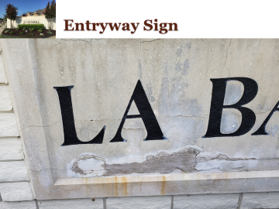

Projects
Entrances
  Shrubs generally doing well, but need to replace a few
Lighting
  Using inexpensive solar landscape lights
  Continuing to consider complete solar systems for each monument, but orientation/placement somewhat challenging
Sign Maintenance
  All four “La Bandera” signs have cracks;
  two have had ‘patch up’ work
  Need replacement

Slide 9
Sign Replacement Plan
Assume a Not To Exceed cost of $20k for the entire project (2022 assumption – may be higher now)
  Four new signs, installed
  Solar powered lighting?
Collect $50/property ($5550 total) per year for four years to cover the cost
  2023 / 2024 / 2025 / 2026
Detailed planning and source selection in the second half of 2025
Perform installation in 2026

Slide 10
Discussion
Is it time to hire a Management Company?
  Still need a minimum of three Directors
  Officer duties can be assumed by management company
Other ideas discussion items?

Slide 11
Election of New Board Members
One
Two
Three
…

Slide 13
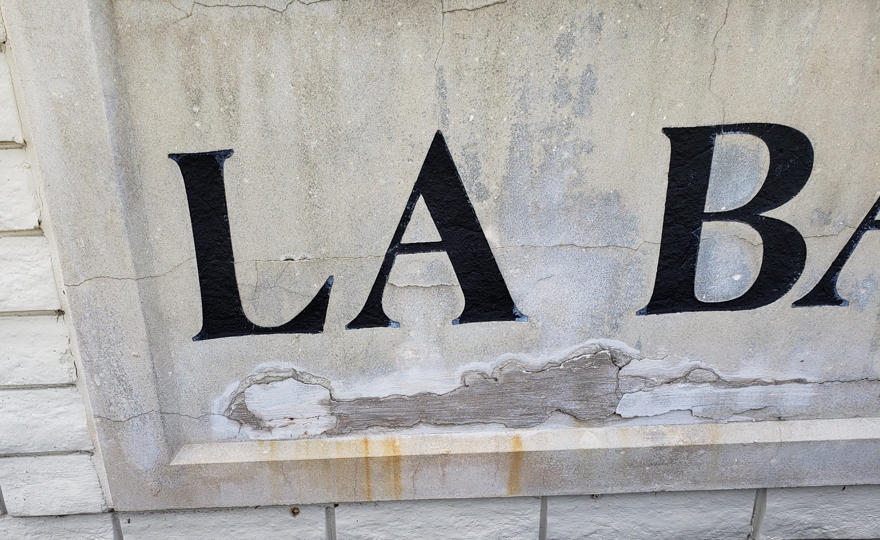
Entryway Sign

Slide 14


Quote from FastSigns
Panface Sign
$2k - $3k each
Front and Back Lit Cabinet Sign With Routed Letters
$4k - $6k each
Does not include any solar power lighting options

