Slide 1
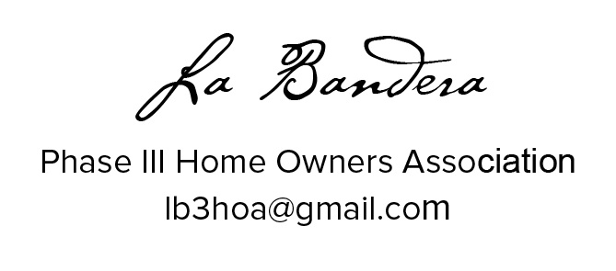

Slide 2
Did you sign the voting/attendance list?
    If not, please do so now
    One signature is required for each address present
    This list is used to verify our ballot totals for elections
    Each address is allowed one vote/one ballot

Slide 3
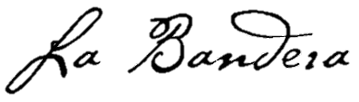
Meeting Agenda
Introduce Current Board Members
HOA Organization
HOA Mission
Financial Overview
Projects
Community Engagement
Discussion Items
Election of new Board Members

Slide 4
2022/23 Board
Board Member Office
Eron Ellis (President)
Shannon Hart (Secretary)
David Hudgins
David Jeffreys (Treasurer)
Renae Patoskie

Slide 5
HOA Organization
Team Ranch
Master Association
Part of the HOA dues
collected is paid to the Master Association
Control of La Bandera Phase 3 HOA was passed to residents in 2007
La Bandera Phase 3 has 111 Homes – La Bandera, Teja, Arroyo, Plata, Pico
La Bandera Phase 3
La Bandera Phase 1 & 2
La Cantera
Reata Place
Reata West
Etc.

Slide 6
HOA Mission
Maintain our community for the common good and general welfare of the subdivision and its members
Enhance the property values for all residents
Ensure compliance with neighborhood Covenants and Restrictions; approve/disapprove significant property changes
Operate the HOA efficiently and economically
Oversee necessary maintenance and/or improvements
Communicate HOA events to neighborhood
Support the integrity of Team Ranch Master Association

Slide 7
Financial Overview
2017 - 2022 Budgetary Analysis
Expense Type | 2017 | 2018 | 2019 | 2020 | 2021 | 2022
Master Dues | $ 8,349 | $ 8,349 | $ 8,349 | $ 8,349 | $ 8,351 | $ 8,351
Landscape | $ 5,318 | $ 4,812 | $ 4,874 | $ 5,467 | $ 4,963 | $ 5,661
Wall Fund | $ 5,000 | $ 5,000 | $ 5,000 | $ 11,100 | $ 5,500 | $ 5,500
Insurance | $ 2,343 | $ 2,674 | $ 2,921 | $ 3,067 | $ 2,595 | $ 2,883
Maintenance/Repairs | $ 848 | $ 3,947 | $ 11,245 | $ 1,124 | $ 7,037 | $ 1,018
Water | $ 1,294 | $ 2,888 | $ 1,851 | $ 1,458 | $ 997 | $ 724
Postage | $ 214 | $ 118 | $ 250 | $ 233 | $ 260 | $ 246
Website | $ 102 | $ 102 | $ 102 | $ 115 | $ 115 | $ 115
Other | $ 30 | $ 38 |  |  | $ 21 | $ 296
Total per house | $ 212 | $ 252 | $ 312 | $ 278 | $ 269 | $ 223
Master Dues – unchanged for 2023
Landscape
  2022 - contract increased to $5924 in 2022
Wall Fund
  Did a “catch up” contribution in 2020; now setting aside $5,500 / year as agreed with city of Benbrook
Maintenance/Repairs
  2018 – attempted upgrade to electrify our entryways ($2,500)
  2019 – major wall refurbishment ($10,616) – money taken from Wall Fund
  2021 – entryway refurbishment ($6,700) – stone edging, remove and replace plants
Water
  Water Smart web portal allowing close monitoring of water usage – no more “surprise” bills
  Keep sprinklers off as much as possible; minimize use when necessary
  Using soaker hoses with timers on shrub beds
Now earning 3.64% on our Wall Fund

Slide 8
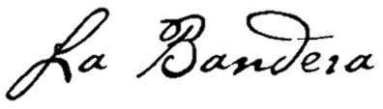
Projects
Spectrum Installation (not an HOA project)
  Spectrum is installing fiber optic infrastructure in the neighborhood; completion date not known
Entrances
  New shrubs generally doing well, but need to replace a few
  Weed & Feed applied all long LB3’s frontage area
Lighting
  Using inexpensive solar landscape lights
  Continuing to consider complete solar systems for each monument, but orientation/placement somewhat challenging
  May roll into the sign refurbishment project
Sign Maintenance
  All four “La Bandera” signs have cracks; two have had ‘patch up’ work
  Need professional repair/restoration or possible replacement

Slide 9
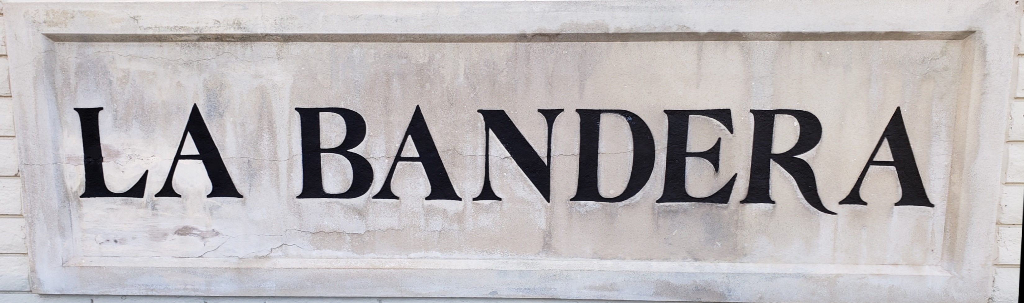
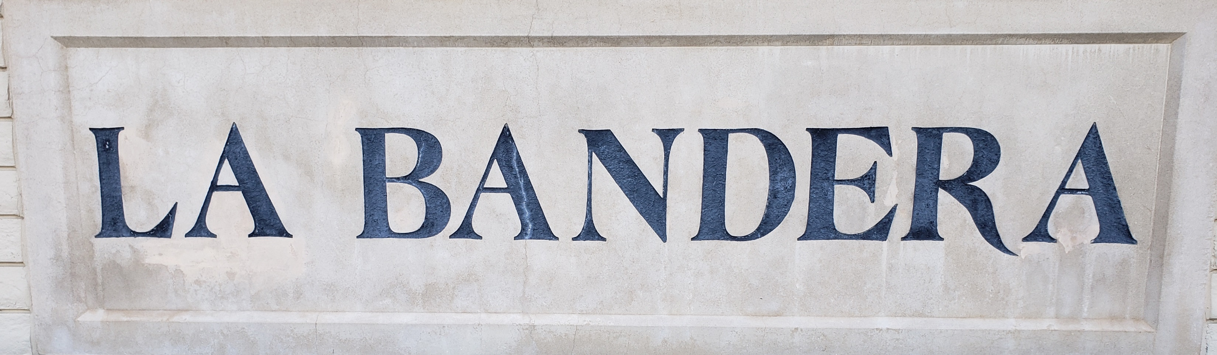
La Bandera Entries

Slide 10
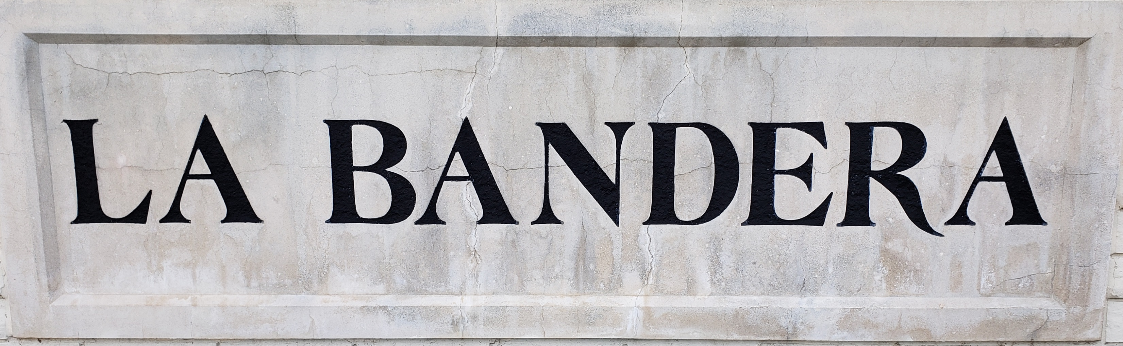
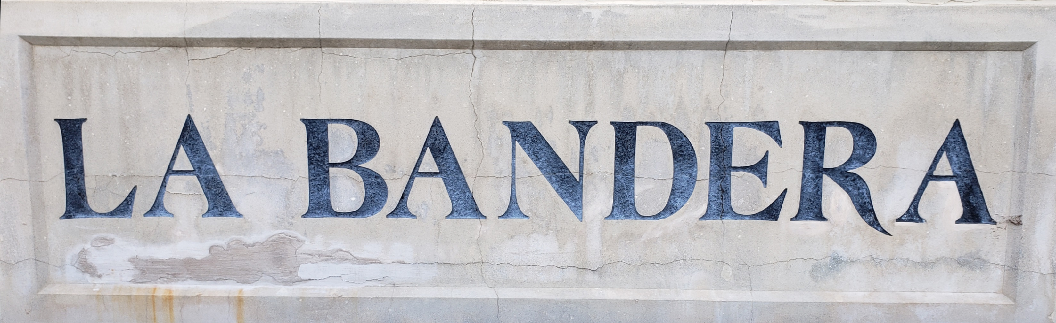
Plata Entries

Slide 11
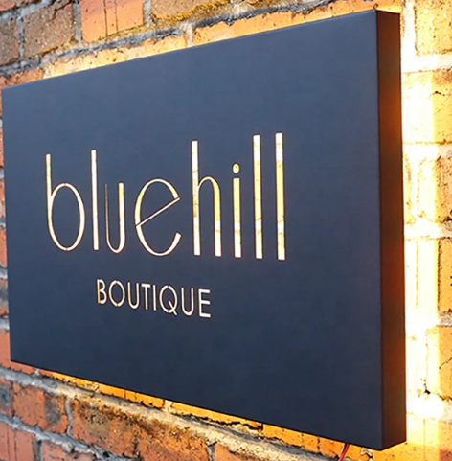
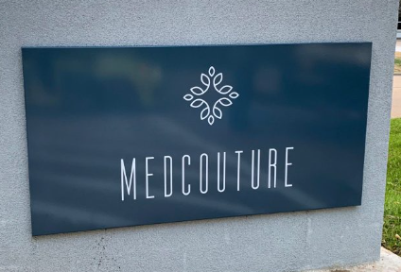
Quote from FastSigns
Panface Sign
$2k - $3k each
Front and Back Lit Cabinet Sign With Routed Letters
$4k - $6k each
Does not include any solar power lighting options

Slide 12
Current Plan
Assume a Not To Exceed cost of $20k for the entire project
  Four new signs, installed
  Solar powered lighting?
Collect $50/house ($5550 total) per year for four years to cover the cost
  2023 / 2024 / 2025 / 2026
Detailed planning and source selection in the second half of 2025
Perform installation in 2026

Slide 13
Community Engagement
Neighborhood Beautification Projects
HOA Potlucks
Neighborhood Garage Sale
Yard of the Month
Other ideas?

Slide 14
Discussion Items
Shingles / Roofing
Time & Location of future annual meetings
Unattractive properties
Other…

Slide 15
Election of New Board Members
Incumbents Willing to Continue
Eron Ellis
Shannon Hart
David Hudgins
David Jeffreys
Renae Patoskie
NEW
Terri Gunther
Jana Isaacs
George Foster

