Slide 1


Slide 2
Did you sign the voting/attendance list?
    If not, please do so now.
    One signature is required for each address present.
    This list is used to verify our ballot totals for the election of the board at the end of this meeting.
    Each address is allowed one vote/one ballot.

Slide 3

Meeting Agenda
Introduce 2017/18 Board
HOA Organization
HOA Mission
Recap of HOA Actions
Financial Overview
Beautification Projects
Upcoming Events
Review of Board Positions
Election for 2017/18 Board
Guest Speaker

Slide 4

Introduce 2016/17 Board
President: Mike Seraphin
Vice President: Anita Mitchell
Secretary: Shannon Hart
Architectural Control Chair/Member At Large: Ken Hassler
Treasurer: David Jeffreys

Slide 5
HOA Organization
Team Ranch
Master Association
La Bandera Phase 1/2
La Bandera Phase 3
Part of the HOA dues collected is paid to the Master Association
Control of La Bandera Phase 3 HOA was passed to residents in 2007
La Bandera Phase 3 has 111 Homes – La Bandera, Tejas, Arroyo, Plata, Pico

Slide 6
HOA Mission
Maintain our community for the common good and general welfare of the subdivision and its members
Enhance the property values for all residents
Uphold the integrity of Team Ranch Master Association

Slide 7
Recap of HOA Actions
Transition of Board
Established 2018 budget and calendar
Continued aggressive cost control measures
Coordinated multiple beautification projects
Collections of dues
Hosted neighborhood-wide cookout
Sponsored neighborhood-wide garage sale
Updated and maintained online presence (Nextdoor, website, Facebook)
Resolved issues, complaints and requests

Slide 8
Financial Overview
2010 – 2017 Budgetary Analysis
Aggressive focus on controlling expenses paid off
Expense Type | 2010 | 2011 | 2012 | 2013 | 2014 | 2015 | 2016 | 2017
Master Dues | 7,203 | 7,203 | 7,203 | 7,203 | 7,203 | 8,349 | 8,349 | 8,349
Landscape | 6,468 | 6,550 | 7,740 | 7,699 | 7,231 | 8,054 | 11,754 | 5,318
Wall Fund | 5,000 | 5,045 | 5,086 | 5,000 | 5,000 | 5,000 | 5,000 | 5,000
Insurance | 1,931 | 1,931 | 1,956 | 1,963 | 2,029 | 2,198 | 2,643 | 2,343
Water | 2,848 | 1,425 | 1,079 | 693 | 2,022 | 1,489 | 1,978 | 1,294
Maintenance/Repairs | 557 | 1,395 |  | 1,591 | 1,120 | 2,087 | 1,658 | 848
Other | 131 | 185 | 186 | 1,039 | 388 | 386 | 591 | 346
Total per House | 236 | 232 | 228 | 245 | 243 | 266 | 306 | 230

Slide 9

Financial Overview
2018 Budget
Dues for the year 2018 increased by $25 per household to partially cover the cost assessed for a much-requested front entrance lighting
As such, dues for 2018 total $275 per household. The special project assessment is a one-time expense and we hope to go back to dues of $250 the following year, if projected expenses allow it.
Expense Category
Master Dues | $ 8,349
Landscaping | $ 4,500
Wall Fund | $ 5,000
Insurance | $ 2,675
Water | $ 1,500
Maintenance/Repairs | $ 850
Other | $ 350
Electricity | $ 250
Lighting Project | $ 5,000
Per Property | $ 275
HOA dues for 2018 are $275
108 of 111 2018 dues have been collected (one of the three is in foreclosure)
Operating fund balance is $17,434
Wall Fund savings account balance is $46,951
  We have about 1500 feet of wall, plus the four entry signs

Slide 10
Beautification Projects
Trees on Cook Ranch
  Mike Seraphin is working to cut back trees
Front Entrance Plantings
  Volunteers planted front beds
  Plants are perennials and return, but may need to be replaced on occasion
Sprinklers
  Installed water valve off Plata for hand-watering/clean-up
  Sprinklers will need some repair due to winter breakage

Slide 11
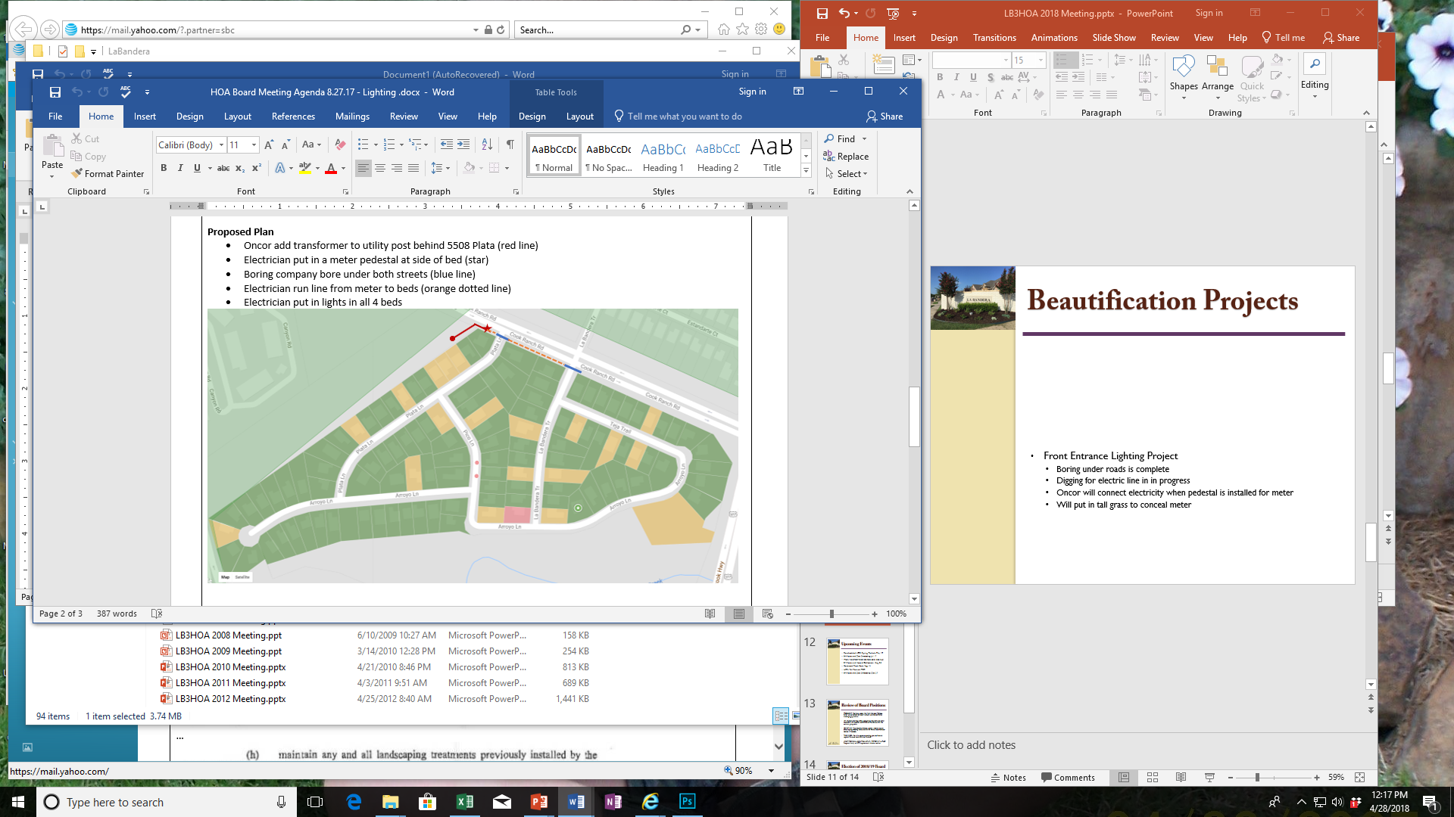
Beautification Projects
Front Entrance Lighting Project
Oncor add transformer to post behind 5508 Plata (red line)
Electrician put in a meter pedestal at side of bed (star)
Boring company bore under both streets (blue line)
Electrician run line from meter to beds (orange dotted line)
Electrician put in lights in all 4 beds

Slide 12
Beautification Projects
Front Entrance Lighting Project Update
  Boring under roads is complete
  Digging for electric line in in progress
  Oncor will connect electricity when pedestal is installed for meter
  Will put in tall grass to conceal meter

Slide 13
Upcoming Events
LB3 Beautification Projects: May
Rescheduled HOA Spring Potluck: May 19
E-Waste and Doc Shredding: Jul 17
HOA Neighborhood Garage Sale: late Aug
E-Waste and Hazard Collection: Aug 25
Benbrook Trash Bash: Sep 15
HOA Fall Potluck: TBD
E-Waste and Doc Shredding: Oct 27
2019 Dues Collection: Jan 1
Annual Board Meeting/Election: Apr

Slide 14
Review of Board Positions
PRESIDENT: Retrieve weekly mail from the local PO box, follow up collections of dues in January, oversee entrance landscaping/sprinklers.
VP: Maintain the HOA Email account to reply/forward, email neighbors with updates, coordinate spring potluck and late summer garage sale.
SECRETARY: Take meeting minutes, update website, secure annual spring meeting venue and deliver manual door-to-door notices (if needed).
TREASURER: Pay bills, approve spending, provide financial reports, file taxes, send out dues invoices.
ARCHITECTURAL CONTROL CHAIR /MEMBER AT LARGE: Respond, timely, to ACC requests and violation notices.

Slide 15
Election of 2018/19 Board
President:
Vice President:
Secretary:
Architectural Control Chair/Member At Large:
Treasurer:

