Slide 1

La Bandera Phase III Homeowners Association
June 5, 2016
Welcome to our Special Meeting

Slide 2
BEFORE WE BEGIN
Did you sign the voting/attendance list?
  If not, please do so now.
  One signature is required for each address present.
  This list is used to verify our ballot totals for the election of the board at the end of this meeting.
  Each address is allowed one vote/one ballot.
La Bandera Phase III

Slide 3
AGENDA
Introduce Board and Committee Members
Review of Annual HOA Meeting and Actions Taken
Review Board Positions and Duties
Election of 2016 – 2017 board members
La Bandera Phase III

Slide 4
CURRENT BOARD MEMBERS
President: Terri Gunther
Vice-President: Rhian Landowski
Treasurer: Nathan Head
Secretary: Wendy Dyba
Member-At-Large: Aaron Mangum
La Bandera Phase III

Slide 5
Review of Most Recent Annual Meeting

Slide 6
Annual Meeting – April 2016
Existing board, in office since 2013, declined to run again. There were no volunteers to fill the vacant positions.
Board decided to hold a special meeting in June and decide, at that time, to either go with a 3rd party management company or, hopefully, locate volunteers.
Board researched 4 management companies. The bids ranged from $750 to $1,200 monthly. This correlates to an $81 to $130 annual dues increase per homeowner; however, a board will still need to be present since no management company would handle 100% of all tasks.
La Bandera Phase III

Slide 7
Review Board Member Duties

Slide 8
Board Member Duties
PRESIDENT: Retrieve weekly mail from the local PO box, follow up collections of dues in January, oversee entrance landscaping/sprinklers.
VP: Maintain the HOA Email account to reply/forward, email neighbors with updates, coordinate spring potluck and late summer garage sale.
SECRETARY: Take meeting minutes, update website, secure annual spring meeting venue and deliver manual door-to-door notices (if needed).
TREASURER: Pay bills, approve spending, provide financial reports, file taxes, send out dues invoices.
ACC Chair/Member at Large: Respond, timely, to ACC requests and violation notices.
La Bandera Phase III

Slide 9
Questions?
La Bandera Phase III

Slide 10
Election of
2016 – 2017 Board Members

Slide 11
Other slides past this point are from the Annual Meeting and are here for reference

Slide 12
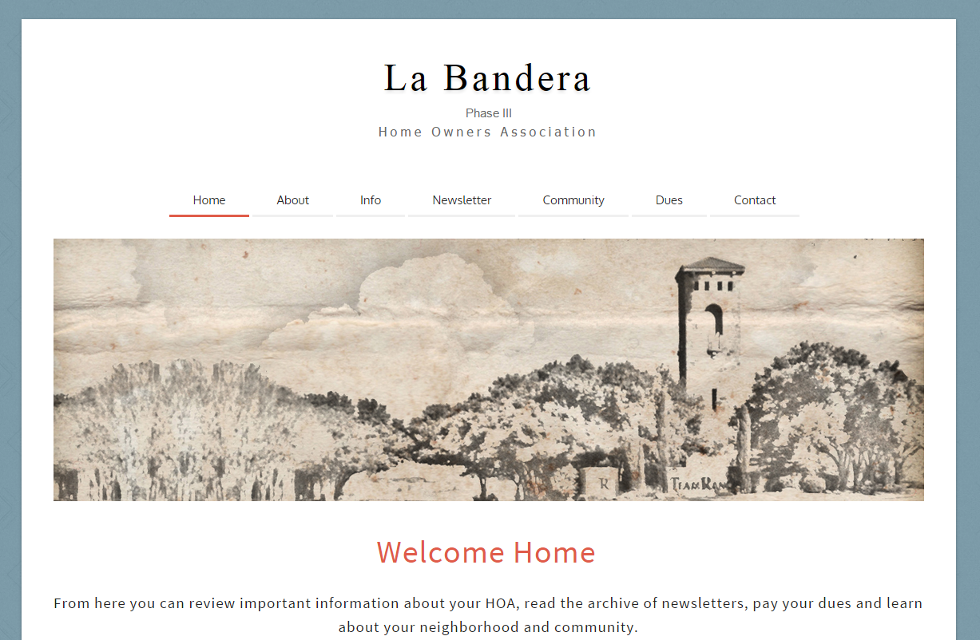
http://labanderaphase3.org/ http://www.facebook.com/lb3hoa
La Bandera Phase III

Slide 13
Financial Statements & Forecast

Slide 14
HOA Collected all Prior Year Dues
 | Outstanding Dues - Current
 | Year | Number | Amount
 | 2007 | 0 | 0
 | 2008 | 0 | 0
 | 2009 | 0 | 0
 | 2010 | 0 | 0
 | 2011 | 0 | 0
 | 2012 | 0 | 0
 | 2013 | 0 | 0
 | 2014 | 0 | 0
 | 2015 | 0 | 0
 | 2016 | 1 | 210
 | Total | 1 | 210
La Bandera Phase III

Slide 15
HOA Actual vs. Budget
 |  |  | Actual | Budget | Over (Under)
 | 2015 Financial Statement
 |  | Dues | 24,975.00 | 24,975.00 | 0.00
 |  | Late Fees | 160.76 | 0.00 | 160.76
 |  | Title Fees | 300.00 | 0.00 | 300.00
 | Total Revenue |  | 25,435.76 | 24,975.00 | 460.76
 |  | Team Ranch Dues | 8,348.70 | 7,202.80 | 1,145.90 | ***
 |  | Lawn Care | 8,053.90 | 7,500.00 | 553.90 | ****
 |  | Wall Fund | 5,550.00 | 5,550.00 | 0.00
 |  | Water | 1,489.37 | 1,750.00 | (260.63)
 |  | Insurance | 2,198.00 | 2,200.00 | (2.00) | **
 |  | Repairs | 2,147.17 | 500.00 | 1,647.17 | *
 |  | Postage | 201.51 | 200.00 | 1.51
 | Total Expenses |  | 27,988.65 | 24,902.80 | 3,085.85
 | Total Surplus |  | (2,552.89) | 72.20 | (2,625.09)
 |  | * 100% Irrigation repairs (cars driving over sprinkler heads/new cable lines)
 |  | ** Insurance rates increased by $500 in 2016
 |  | *** Team Ranch Raised dues without notice
 |  | **** We will be over budget on Landscaping by $4.5K in 2016 (used xs funds)
La Bandera Phase III

Slide 16
HOA Budget - $250 Dues
2015
2016
La Bandera Phase III

Slide 17
HOA Financial Position
 |  | ASSETS
 |  | Cash | 15,480.61
 |  | Cash (CDs) | 30,000.00
 |  | A/R Unpaid Dues | 210.00
 |  | LIABILITIES
 |  | Master HOA Payable - 2016 | 0.00
 |  | 2016 Prepaid HOA Dues | 0.00
 |  | Wall Maint Fund | (38,850.00)
 |  | Est. Water Through Feb 2017 | (1,416.67)
 |  | Est. Lawn Care Through Feb 2017 | (5,125.50)
 |  | Est. Postage Through Feb 2017 | (200.00)
 |  | Est. Repairs Through Feb 2017 | 0.00
 |  | EQUITY - NET ASSETS | 98.44
La Bandera Phase III

Slide 18
Wish List (Pending Projects)
Suggestions?
La Bandera Phase III

Slide 19
Neighborhood
Crime Watch
Presentation

Slide 20
Protect La Bandera
La Bandera HOA has an organized Benbrook Neighborhood Watch program. Members are constantly on the lookout for suspicious activity, open garage doors, unusual cars not normally in the neighborhood, and other various signs of possible criminal activity.
If you happen to spot anything suspicious please do not hesitate to call the City of Benbrook at 817-249-4803 or dial 911 if it is an emergency.
If you are interested in volunteering please contact the HOA.
La Bandera Phase III

Slide 21
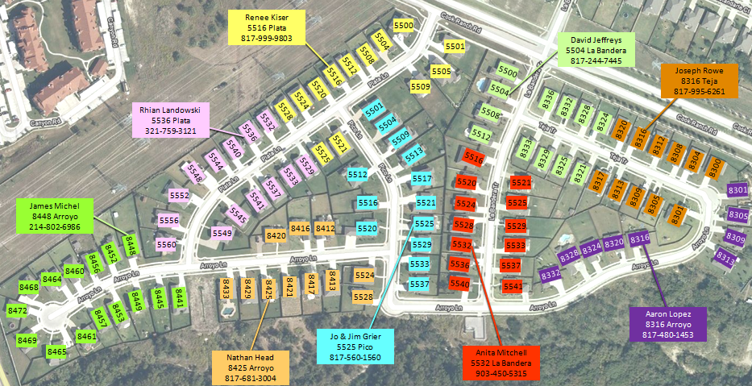
Current Neighborhood Division
La Bandera Phase III

Slide 22
Architectural
Control
Committee (ACC)

Slide 23
ACC Member Duites
The purpose of the ACC is to assure that any installation, construction, or alteration of any structure is in conformity and harmony of external design and general quality of the subdivision.
No structure shall be commenced, erected, placed, moved onto, or permitted to remain on any lot, nor shall any existing structure or lot, including without limitation, any change of exterior color, unless plans and specifications therefore shall have been submitted to and approved in writing by the ACC.
La Bandera Phase III

Slide 24
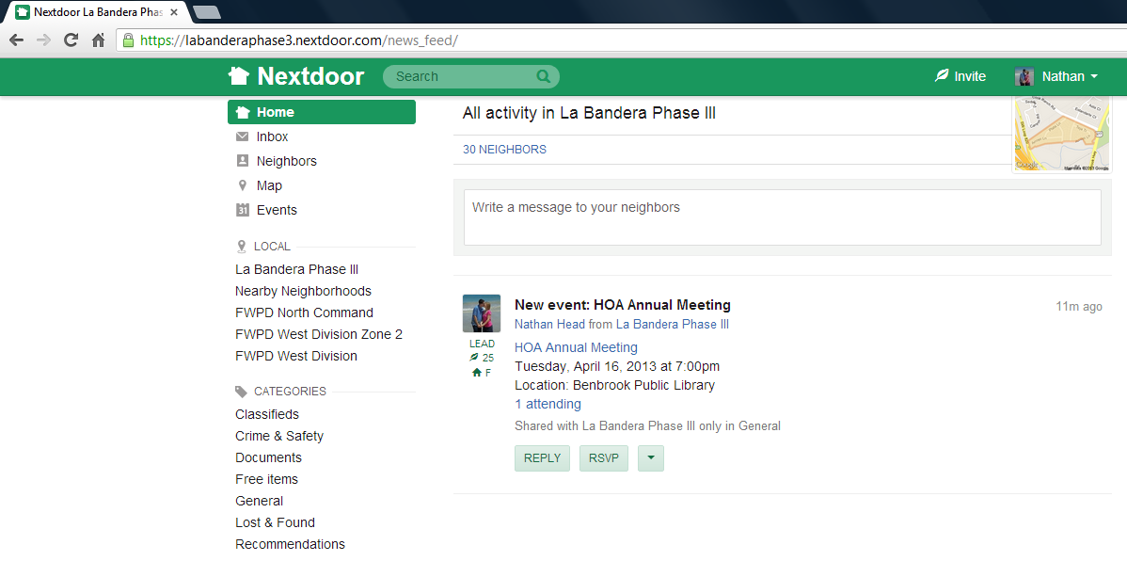
www.NextDoor.com
If you would like to join our neighborhood network please send an email to lb3hoa@gmail.com.

