Slide 1

La Bandera Phase III Homeowners Association
April 24, 2016
Welcome to our Annual Meeting

Slide 2
BEFORE WE BEGIN
Did you sign the voting/attendance list?
  If not, please do so now.
  One signature is required for each address present.
  This list is used to verify our ballot totals for the election of the board at the end of this meeting.
  Each address is allowed one vote/one ballot.
La Bandera Phase III

Slide 3
AGENDA
Introduce board and committee members
Review of past 12 months HOA actions
Financial statements and forecast
Review Protect La Bandera (Neighborhood Watch Program)
Review Architectural Control Committee (ACC)
Review NextDoor
Election of 2016 – 2017 board members
La Bandera Phase III

Slide 4
Introduce Board,
ACC, and Protect
La Bandera
Members

Slide 5
CURRENT BOARD MEMBERS
President: Terri Gunther
Vice-President: Rhian Landowski
Treasurer: Nathan Head
Secretary: Wendy Dyba
Member-At-Large: Aaron Mangum
La Bandera Phase III

Slide 6
ARCHITECTUAL CONTROL COMMITTEE (ACC)
We need volunteers
PROTECT LA BANDERA
We need volunteers
La Bandera Phase III

Slide 7
Review of Past 12 Months’ Board Actions

Slide 8
Board Actions 2015-2016
Reviewed annual maintenance and insurance contracts.
Reviewed various ACC requests.
Held annual homeowner picnic.
Held annual trash-out event.
Replaced front entrance trees.
Added new sprinkler zones to front entrances.
La Bandera Phase III

Slide 9
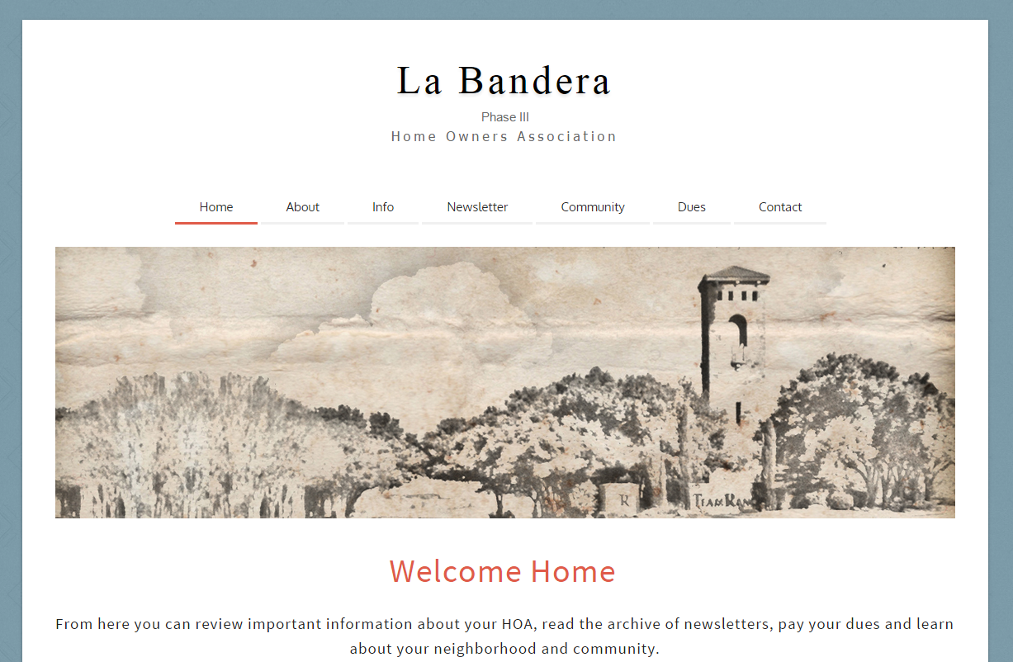
http://labanderaphase3.org/ http://www.facebook.com/lb3hoa
La Bandera Phase III

Slide 10
Financial Statements & Forecast

Slide 11
HOA Collected all Prior Year Dues
 | Outstanding Dues - Current
 | Year | Number | Amount
 | 2007 | 0 | 0
 | 2008 | 0 | 0
 | 2009 | 0 | 0
 | 2010 | 0 | 0
 | 2011 | 0 | 0
 | 2012 | 0 | 0
 | 2013 | 0 | 0
 | 2014 | 0 | 0
 | 2015 | 0 | 0
 | 2016 | 1 | 210
 | Total | 1 | 210
La Bandera Phase III

Slide 12
HOA Actual vs. Budget
 |  |  | Actual | Budget | Over (Under)
 | 2015 Financial Statement
 |  | Dues | 24,975.00 | 24,975.00 | 0.00
 |  | Late Fees | 160.76 | 0.00 | 160.76
 |  | Title Fees | 300.00 | 0.00 | 300.00
 | Total Revenue |  | 25,435.76 | 24,975.00 | 460.76
 |  | Team Ranch Dues | 8,348.70 | 7,202.80 | 1,145.90 | ***
 |  | Lawn Care | 8,053.90 | 7,500.00 | 553.90 | ****
 |  | Wall Fund | 5,550.00 | 5,550.00 | 0.00
 |  | Water | 1,489.37 | 1,750.00 | (260.63)
 |  | Insurance | 2,198.00 | 2,200.00 | (2.00) | **
 |  | Repairs | 2,147.17 | 500.00 | 1,647.17 | *
 |  | Postage | 201.51 | 200.00 | 1.51
 | Total Expenses |  | 27,988.65 | 24,902.80 | 3,085.85
 | Total Surplus |  | (2,552.89) | 72.20 | (2,625.09)
 |  | * 100% Irrigation repairs (cars driving over sprinkler heads/new cable lines)
 |  | ** Insurance rates increased by $500 in 2016
 |  | *** Team Ranch Raised dues without notice
 |  | **** We will be over budget on Landscaping by $4.5K in 2016 (used xs funds)
La Bandera Phase III

Slide 13
HOA Budget - $250 Dues
2015
2016
La Bandera Phase III

Slide 14
HOA Financial Position
 |  | ASSETS
 |  | Cash | 15,480.61
 |  | Cash (CDs) | 30,000.00
 |  | A/R Unpaid Dues | 210.00
 |  | LIABILITIES
 |  | Master HOA Payable - 2016 | 0.00
 |  | 2016 Prepaid HOA Dues | 0.00
 |  | Wall Maint Fund | (38,850.00)
 |  | Est. Water Through Feb 2017 | (1,416.67)
 |  | Est. Lawn Care Through Feb 2017 | (5,125.50)
 |  | Est. Postage Through Feb 2017 | (200.00)
 |  | Est. Repairs Through Feb 2017 | 0.00
 |  | EQUITY - NET ASSETS | 98.44
La Bandera Phase III

Slide 15
Wish List (Pending Projects)
Suggestions?
La Bandera Phase III

Slide 16
Neighborhood
Crime Watch
Presentation

Slide 17
Protect La Bandera
La Bandera HOA has an organized Benbrook Neighborhood Watch program. Members are constantly on the lookout for suspicious activity, open garage doors, unusual cars not normally in the neighborhood, and other various signs of possible criminal activity.
If you happen to spot anything suspicious please do not hesitate to call the City of Benbrook at 817-249-4803 or dial 911 if it is an emergency.
If you are interested in volunteering please contact the HOA.
La Bandera Phase III

Slide 18
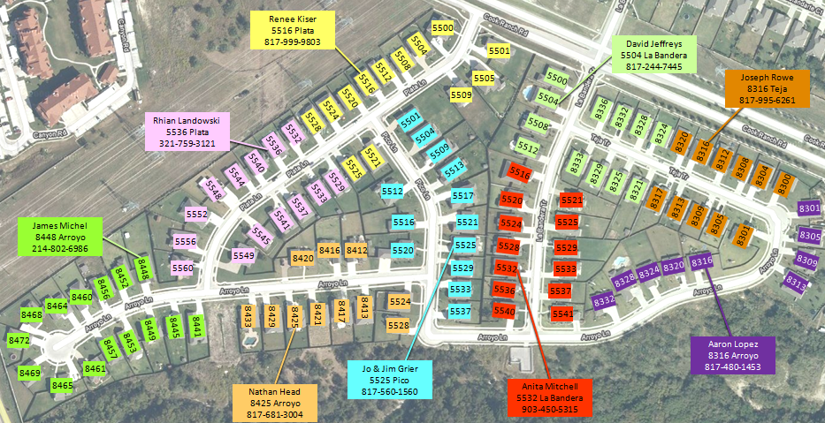
Current Neighborhood Division
La Bandera Phase III

Slide 19
Architectural
Control
Committee (ACC)

Slide 20
ACC Member Duites
The purpose of the ACC is to assure that any installation, construction, or alteration of any structure is in conformity and harmony of external design and general quality of the subdivision.
No structure shall be commenced, erected, placed, moved onto, or permitted to remain on any lot, nor shall any existing structure or lot, including without limitation, any change of exterior color, unless plans and specifications therefore shall have been submitted to and approved in writing by the ACC.
La Bandera Phase III

Slide 21
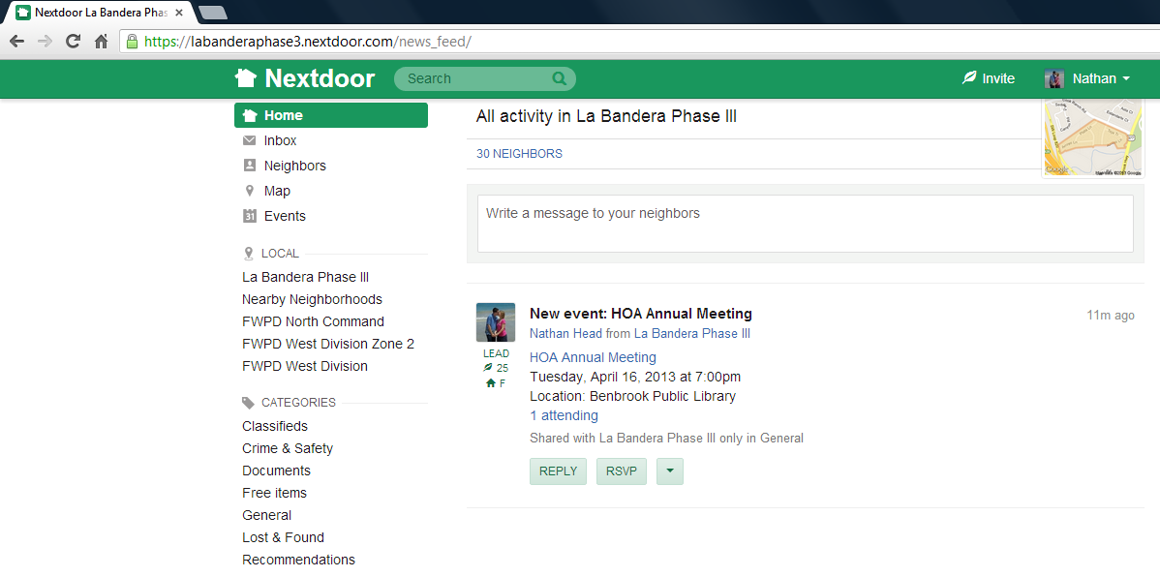
www.NextDoor.com
If you would like to join our neighborhood network please send an email to lb3hoa@gmail.com.

Slide 22
Questions?
La Bandera Phase III

Slide 23
Election of
2016 – 2017 Board Members

