Slide 1

La Bandera Phase III Homeowners Association
April 16, 2013
Welcome to our Annual Meeting

Slide 2
BEFORE WE BEGIN
Did you sign the voting/attendance list?
  If not, please do so now.
  One signature is required for each address present.
  This list is used to verify our ballot totals for the election of the board at the end of this meeting.
  Each address is allowed one vote/one ballot.
La Bandera Phase III

Slide 3
AGENDA
Introduce board and committee members
Review of past 12 months HOA actions
Financial statements and forecast
Review Protect La Bandera (Neighborhood Watch Program)
Review Architectural Control Committee (ACC)
Election of 2013 – 2014 board members
La Bandera Phase III

Slide 4
Introduce Board,
ACC, and Protect
La Bandera
Members

Slide 5
CURRENT BOARD MEMBERS
President: George Foster
Vice-President: Ken Hassler
Treasurer: Nathan Head
Secretary: Donna LaVanway
Member-At-Large: James Michael
La Bandera Phase III

Slide 6
ARCHITECTUAL CONTROL COMMITTEE (ACC)
We need volunteers
PROTECT LA BANDERA
We need volunteers
La Bandera Phase III

Slide 7
Review of Past 12 Months’ Board Actions

Slide 8
Board Actions 2012-2013
Repair sprinkler systems from unknown damage; likely caused by vehicles driving off roadway.
Selected new lawn care maintenance company – Jake’s Lawn Care. Their contract began March 1st.
Renewed annual insurance contracts – there was no increase in premium.
Reviewed various ACC requests.
Attended meetings promoting our Neighborhood Watch.
Created a Nextdoor.com Social Network presence.
La Bandera Phase III

Slide 9
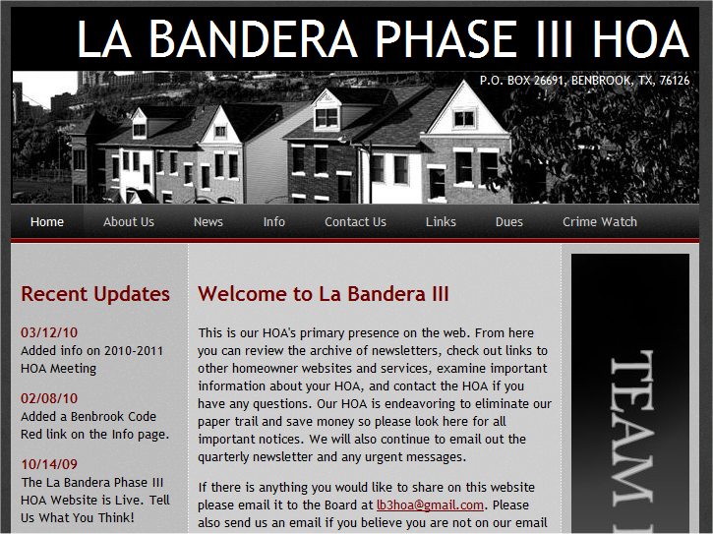
http://labanderaphase3.org/ http://www.facebook.com/lb3hoa
La Bandera Phase III

Slide 10
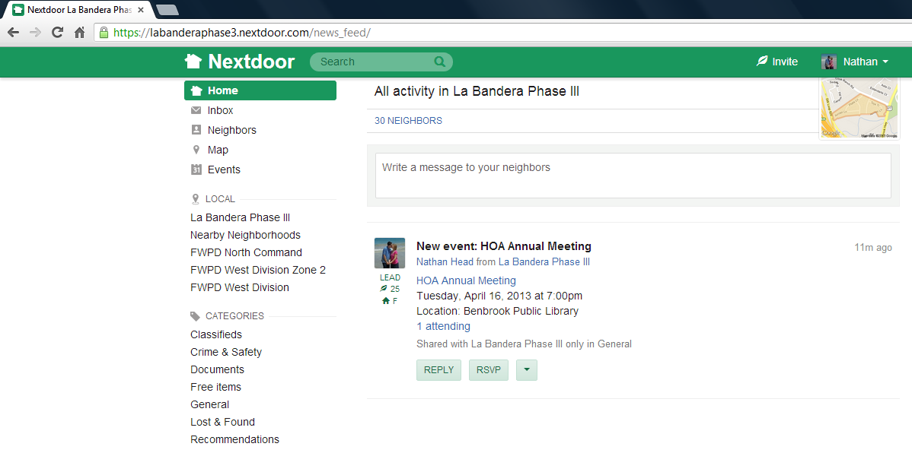
www.NextDoor.com
If you would like to join our neighborhood network please send an email to lb3hoa@gmail.com.

Slide 11
Financial Statements & Forecast

Slide 12
HOA Collected all Prior Year Dues
 | Outstanding Dues - Current
 | Year | Number | Amount
 | 2007 | 0 | 0
 | 2008 | 0 | 0
 | 2009 | 0 | 0
 | 2010 | 0 | 0
 | 2011 | 0 | 0
 | 2012 | 0 | 0
 | 2013 | 0 | 0
 | Total | 0 | 0
La Bandera Phase III

Slide 13
HOA Actual vs. Budget
 |  |  | Actual | Budget | Over (Under)
 | 2012 Financial Statement
 |  | Dues | 24,975.00 | 24,975.00 | 0.00
 |  | Late Fees | 319.40 | 0.00 | 319.40
 |  | Title Fees | 275.00 | 0.00 | 275.00
 | Total Revenue |  | 25,569.40 | 24,975.00 | 594.40
 |  | Team Ranch Dues | 7,202.80 | 7,202.80 | 0.00
 |  | Lawn Care | 7,239.91 | 7,236.00 | 3.91
 |  | Wall Fund | 5,550.00 | 5,550.00 | 0.00
 |  | Water | 1,579.28 | 1,750.00 | (170.72)
 |  | Insurance | 1,956.00 | 1,931.00 | 25.00
 |  | Repairs | 0.00 | 1,000.00 | (1,000.00) | *
 |  | Postage | 62.80 | 170.00 | (107.20)
 | Total Expenses |  | 23,590.79 | 24,839.80 | (1,249.01)
 | Total Surplus |  | 1,978.61 | 135.20 | 1,843.41 | **
 |  | * There was about $500 in repairs during January and February 2013
 |  | ** Mostly due to Late and Title Fees and low Repair Expense
La Bandera Phase III

Slide 14
HOA Budget - $225 Dues
La Bandera Phase III

Slide 15
HOA Dues – Do they seem high?
HOA | Total Dues | Team Ranch | Net Dues | Homes | Acres
La Bandera Phase III | 225 | 65 | 160 | 111 | 33
La Bandera Phase I | 275 | 64 | 211 | 70 | 20
La Bandera Phase II | 275 | 55 | 220 | 40 | 10
Reata Place | 475 | 96 | 379 | 62 | 27
Reata West | 1,150 | 60 | 1,090 | 45 | 12
La Cantera | 2,500 | 310 | 2,190 | 95 | 134
La Bandera Phase III

Slide 16
HOA Financial Position
 |  | ASSETS
 |  | Cash | 16,356.61
 |  | Cash - Wall Maint Fund (CD) | 22,200.00
 |  | A/R Unpaid Dues (0 Homes) | 0.00
 |  | LIABILITIES
 |  | Master HOA Payable - 2013 | 0.00
 |  | 2014 Prepaid HOA Dues | 0.00
 |  | Wall Maint Fund | (22,200.00)
 |  | Est. Water Through Feb 2014 | (2,750.00)
 |  | Est. Lawn Through Feb 2014 | (8,236.00)
 |  | Est. Insurance Through Feb 2014 | 0.00
 |  | Est. Other Through Feb 2014 | (2,170.00)
 |  | EQUITY - NET ASSETS | 3,200.61
La Bandera Phase III

Slide 17
Alternative HOA Management?
Many HOA’s outsource their management to a third party company with expertise.
There are downsides to this alternative:
The cost of these services is approximately $8,000 per year – or an additional $72 per homeowner.
Management company is likely to be significantly more conservative on the application of covenants.
Late fees would be more strictly applied (and much more severe).
Resale certificates are $270 instead of $50.
There are also upsides:
Homeowners would have a more “businesslike” experience with the HOA.
The HOA would be more “patrolled” in terms of covenant violations.
Homeowners who fail to pay dues would be pursued via more formal methods (collection letters and attorney letters instead of door knocking).

Slide 18
Wish List (Pending Projects)
Security cameras and additional lighting at entrances
  Significant cost
  No electrical access to HOA
  There is an alternative – will be discussed later.
Other Suggestions?
La Bandera Phase III

Slide 19
Neighborhood
Crime Watch
Presentation

Slide 20
Protect La Bandera
La Bandera HOA has an organized Benbrook Neighborhood Watch program. Members are constantly on the lookout for suspicious activity, open garage doors, unusual cars not normally in the neighborhood, and other various signs of possible criminal activity.
If you happen to spot anything suspicious please do not hesitate to call the City of Benbrook at 817-249-4803 or dial 911 if it is an emergency.
If you are interested in volunteering please contact the HOA.
La Bandera Phase III

Slide 21
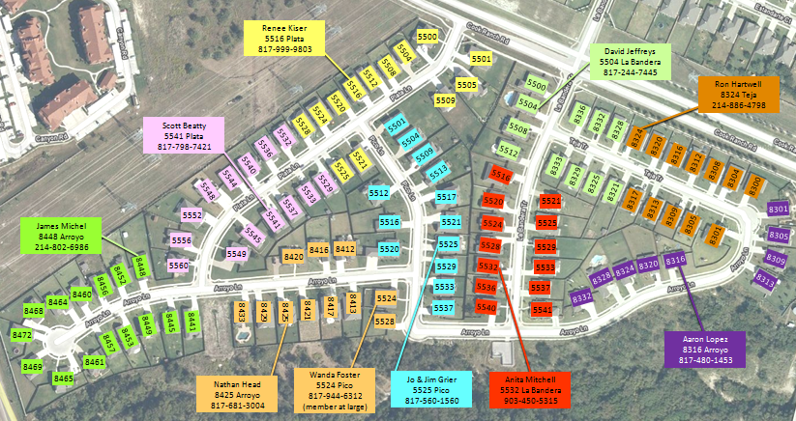
Current Neighborhood Division
La Bandera Phase III

Slide 22
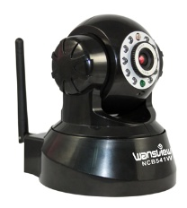
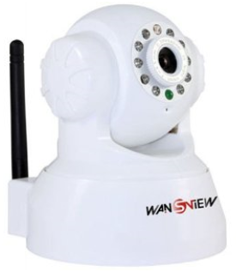
Bandera Camera Movement
http://www.wansview.com/
NCB-541 - $55 on Amazon
Requires WiFi
Motion Detection sends pictures to website which can later be reviewed by local police

Slide 23
Architectural
Control
Committee (ACC)

Slide 24
ACC Member Duites
The purpose of the ACC is to assure that any installation, construction, or alteration of any structure is in conformity and harmony of external design and general quality of the subdivision.
No structure shall be commenced, erected, placed, moved onto, or permitted to remain on any lot, nor shall any existing structure or lot, including without limitation, any change of exterior color, unless plans and specifications therefore shall have been submitted to and approved in writing by the ACC.
La Bandera Phase III

Slide 25
Questions?
La Bandera Phase III

Slide 26
Election of
2013 – 2014 Board Members

