Slide 1

La Bandera Phase III Homeowners Association
April 21, 2010
Welcome to our Annual Meeting

Slide 2
BEFORE WE BEGIN
Did you sign the voting/attendance list?
  If not, please do so now.
  One signature is required for each address present.
  This list is used to verify our ballot totals for the election of the board at the end of this meeting.
  Each address is allowed one vote/one ballot.
La Bandera Phase III

Slide 3
AGENDA
Introduce board and ACC members
Review of past 12 months’ board meetings and actions
Financial statements and forecast
Neighborhood crime watch presentation
Architectural Control Committee (ACC) presentation
Election of 2010 – 2011 board members
La Bandera Phase III

Slide 4
Introduce Board &ACC Members

Slide 5
CURRENT BOARD MEMBERS
President: Jim Grier
Vice-President: Elizabeth Beck-Johnson
Treasurer: Nathan Head
Member-At-Large: Tony Rutigliano
Secretary: Vacant
La Bandera Phase III

Slide 6
ARCHITECTUAL CONTROL COMMITTEE (ACC)
William Day – Chairman
John Sims
Larry Travis
Anita Mitchell
Greg Gable
Ken Hassler
La Bandera Phase III

Slide 7
Review of Past 12 Months’ Board Actions

Slide 8
Board Actions 2009-2010
Began neighborhood crime watch program
Appointed members to the ACC
Collected most homeowner email addresses (board went door-to-door) and began communications with homeowners via email to save printing & postage costs
Increased annual dues from $150 to $175 to cover required expenses (insurance). Purchased HOA property and liability insurance.
HOA website – http://home.swbell.net/nate-sus/hoa/ and Facebook page.
La Bandera Phase III

Slide 9
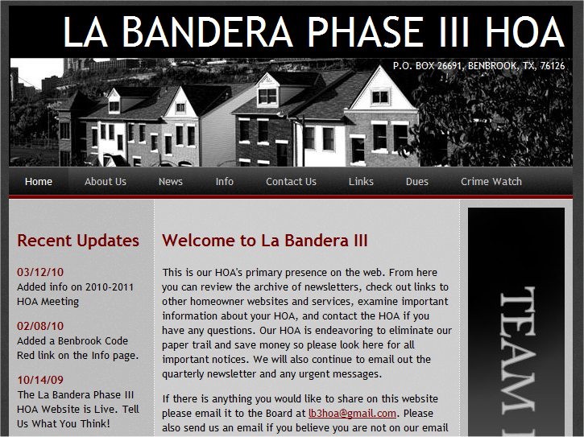
http://home.swbell.net/nate-sus/hoa/
La Bandera Phase III

Slide 10
Board Actions 2009-2010
Established Common Property Maintenance Reserve Fund of $41,000 by 2017 – Created by collecting $5,550 per year or $50 per homeowner (amount set by city of Benbrook) required by LB3 Covenants Article 5.13
Researched and signed contract with new landscaping company.
Implemented quarterly audit of HOA records.
Quarterly newsletter: 1st issue released Sept 30
La Bandera Phase III

Slide 11
Financial Statements & Forecast

Slide 12
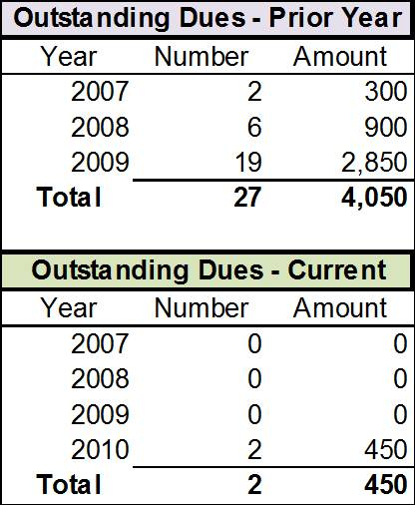
HOA Collected all Prior Year Dues
La Bandera Phase III

Slide 13
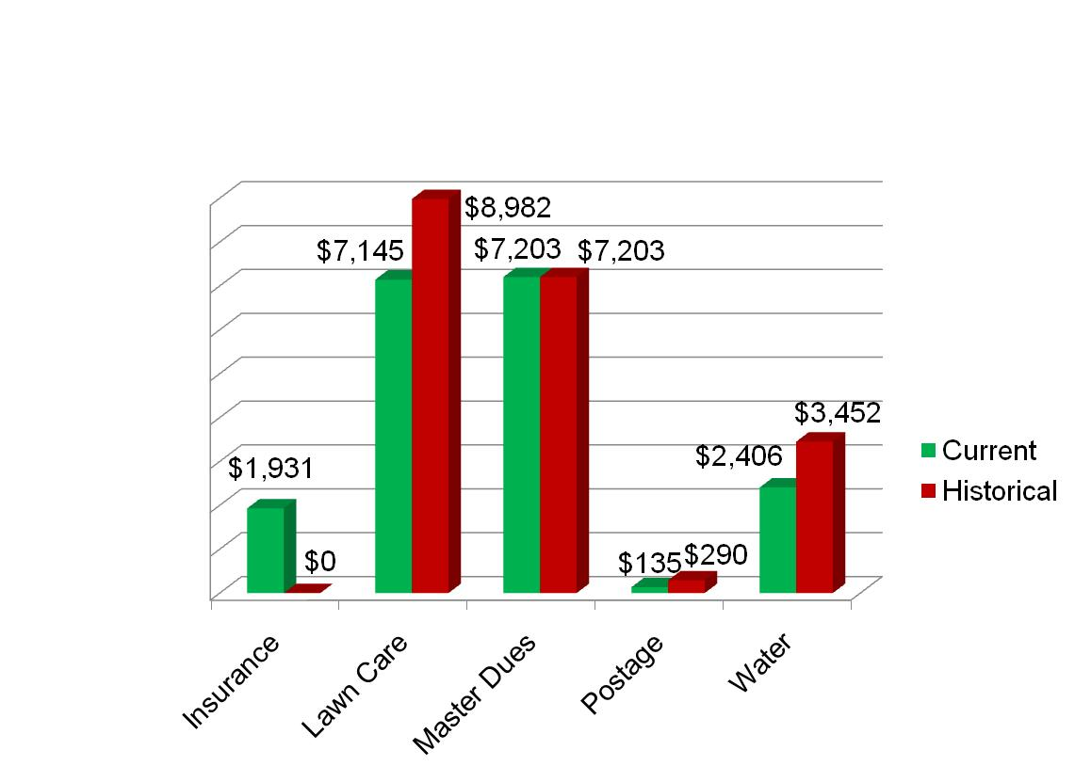
HOA Reduced Certain Expenses
La Bandera Phase III

Slide 14
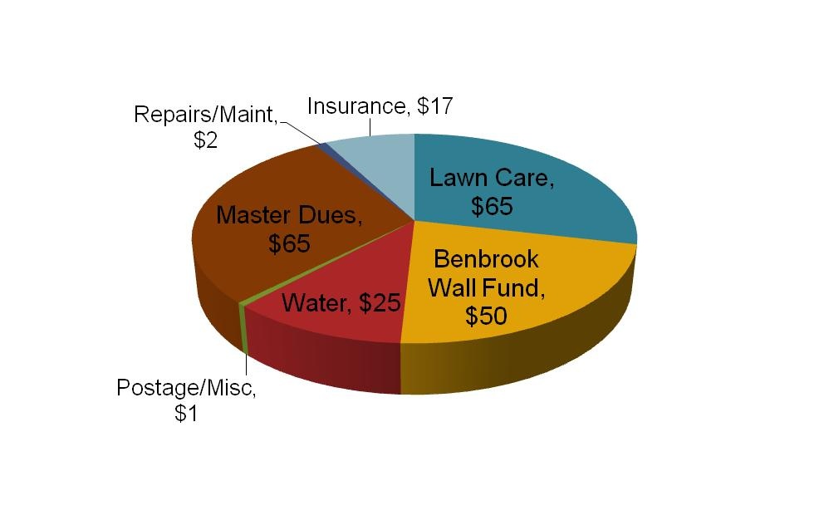
HOA Budget - $225 Dues
La Bandera Phase III

Slide 15
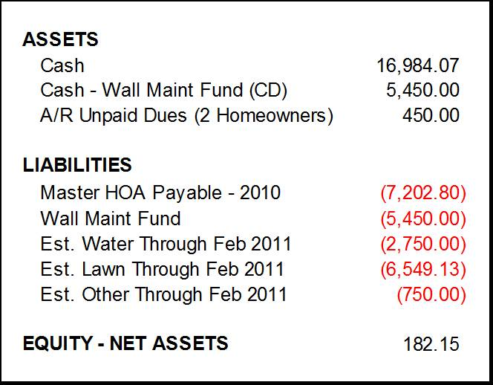
HOA Financial Position
La Bandera Phase III

Slide 16
To-Do List (Pending Projects)
Repair sprinkler system.
Touch-up/Paint La Bandera signs at both front entrances.
Repair East entrance La Bandera sign (steel rebar is showing).
2011+; Add electricity to both front entrances (for lighted signs).
La Bandera Phase III

Slide 17
Neighborhood Crime Watch Presentation

Slide 18
Protect La Bandera
La Bandera HOA has an organized Benbrook Neighborhood Watch program. Members are constantly on the lookout for suspicious activity, open garage doors, unusual cars not normally in the neighborhood, and other various signs of possible criminal activity.
If you happen to spot anything suspicious please do not hesitate to call the City of Benbrook at 817-249-4803 or dial 911 if it is an emergency.
If you are interested in volunteering please contact the HOA.
La Bandera Phase III

Slide 19
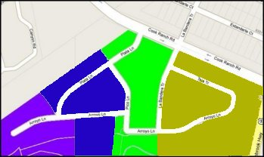
Current Neighborhood Division
La Bandera Phase III

Slide 20
Architectural Control Committee (ACC) Article VI

Slide 21
        When Do We Meet?
  6.04 Operations of the ACC…
  (a) Meetings. The ACC shall hold regular meetings at least once every three (3) months or more often as may be established by the ACC.
  If items are submitted for review, meetings are held more frequently.
  Please submit all requests for approval by the first Monday of the month for consideration in the ACC meeting occurring on the second Monday of each month.
La Bandera Phase III

Slide 22
        What is the Purpose of the ACC?
  6.02 Purpose, Powers and Duties of the ACC.
  The purpose of the ACC is to assure that any installation, construction, or alteration of any structure is in conformity and harmony of external design and general quality of the subdivision.
  6.06 Submission of Plans and Specifications.
  No structure shall be commenced, erected, placed, moved onto, or permitted to remain on any lot, nor shall any existing structure or lot, including without limitation, any change of exterior color, unless plans and specifications therefore shall have been submitted to and approved in writing by the ACC.
La Bandera Phase III

Slide 23
        How to submit plans for review:
        Send an email (lb3hoa@gmail.com) to the ACC or contact the ACC through the HOA webpage for formal review and written approval.
La Bandera Phase III

Slide 24
Accomplishments
Communicated our active participation
Mission: “Maintain the aesthetic integrity of the community effectively maintaining property values”
Developed a process for resolving violations and approving requests
La Bandera Phase III

Slide 25
Myths
We are the neighborhood “police”
We have the authority to force you to remove a structure (built prior to the formation of the ACC) that is deemed noncompliant
LB3 bylaws supersede all other laws
We want to control you
La Bandera Phase III

Slide 26
Questions?
La Bandera Phase III

Slide 27
Election of
2010 – 2011 Board Members

